Slide 1
Emerging Technologies for the Circular Economy
Lecture 11: Blockchains and Sustainability
Prof. Dr. Benjamin Leiding (Clausthal)
M.Sc. Arne Bochem (Göttingen)
M.Sc. Anant Sujatanagarjuna (Clausthal)

Slide 2
License
This work is licensed under a Creative Commons Attribution-ShareAlike 4.0 International License. To view a copy of this license, please refer to https://creativecommons.org/licenses/by-sa/4.0/ .
Updated versions of these slides will be available in our Github repository.

Slide 3
Exam
Pre-Exam Q&A Session
There will be a pre-exam Q&A session before the exam
Where: BBB → ETCE Q&A Room (Link)
When: 29.07.22 - 14:00 - 15:30

Slide 4
Exam
Exam Registration
Please register for the exam

Slide 5
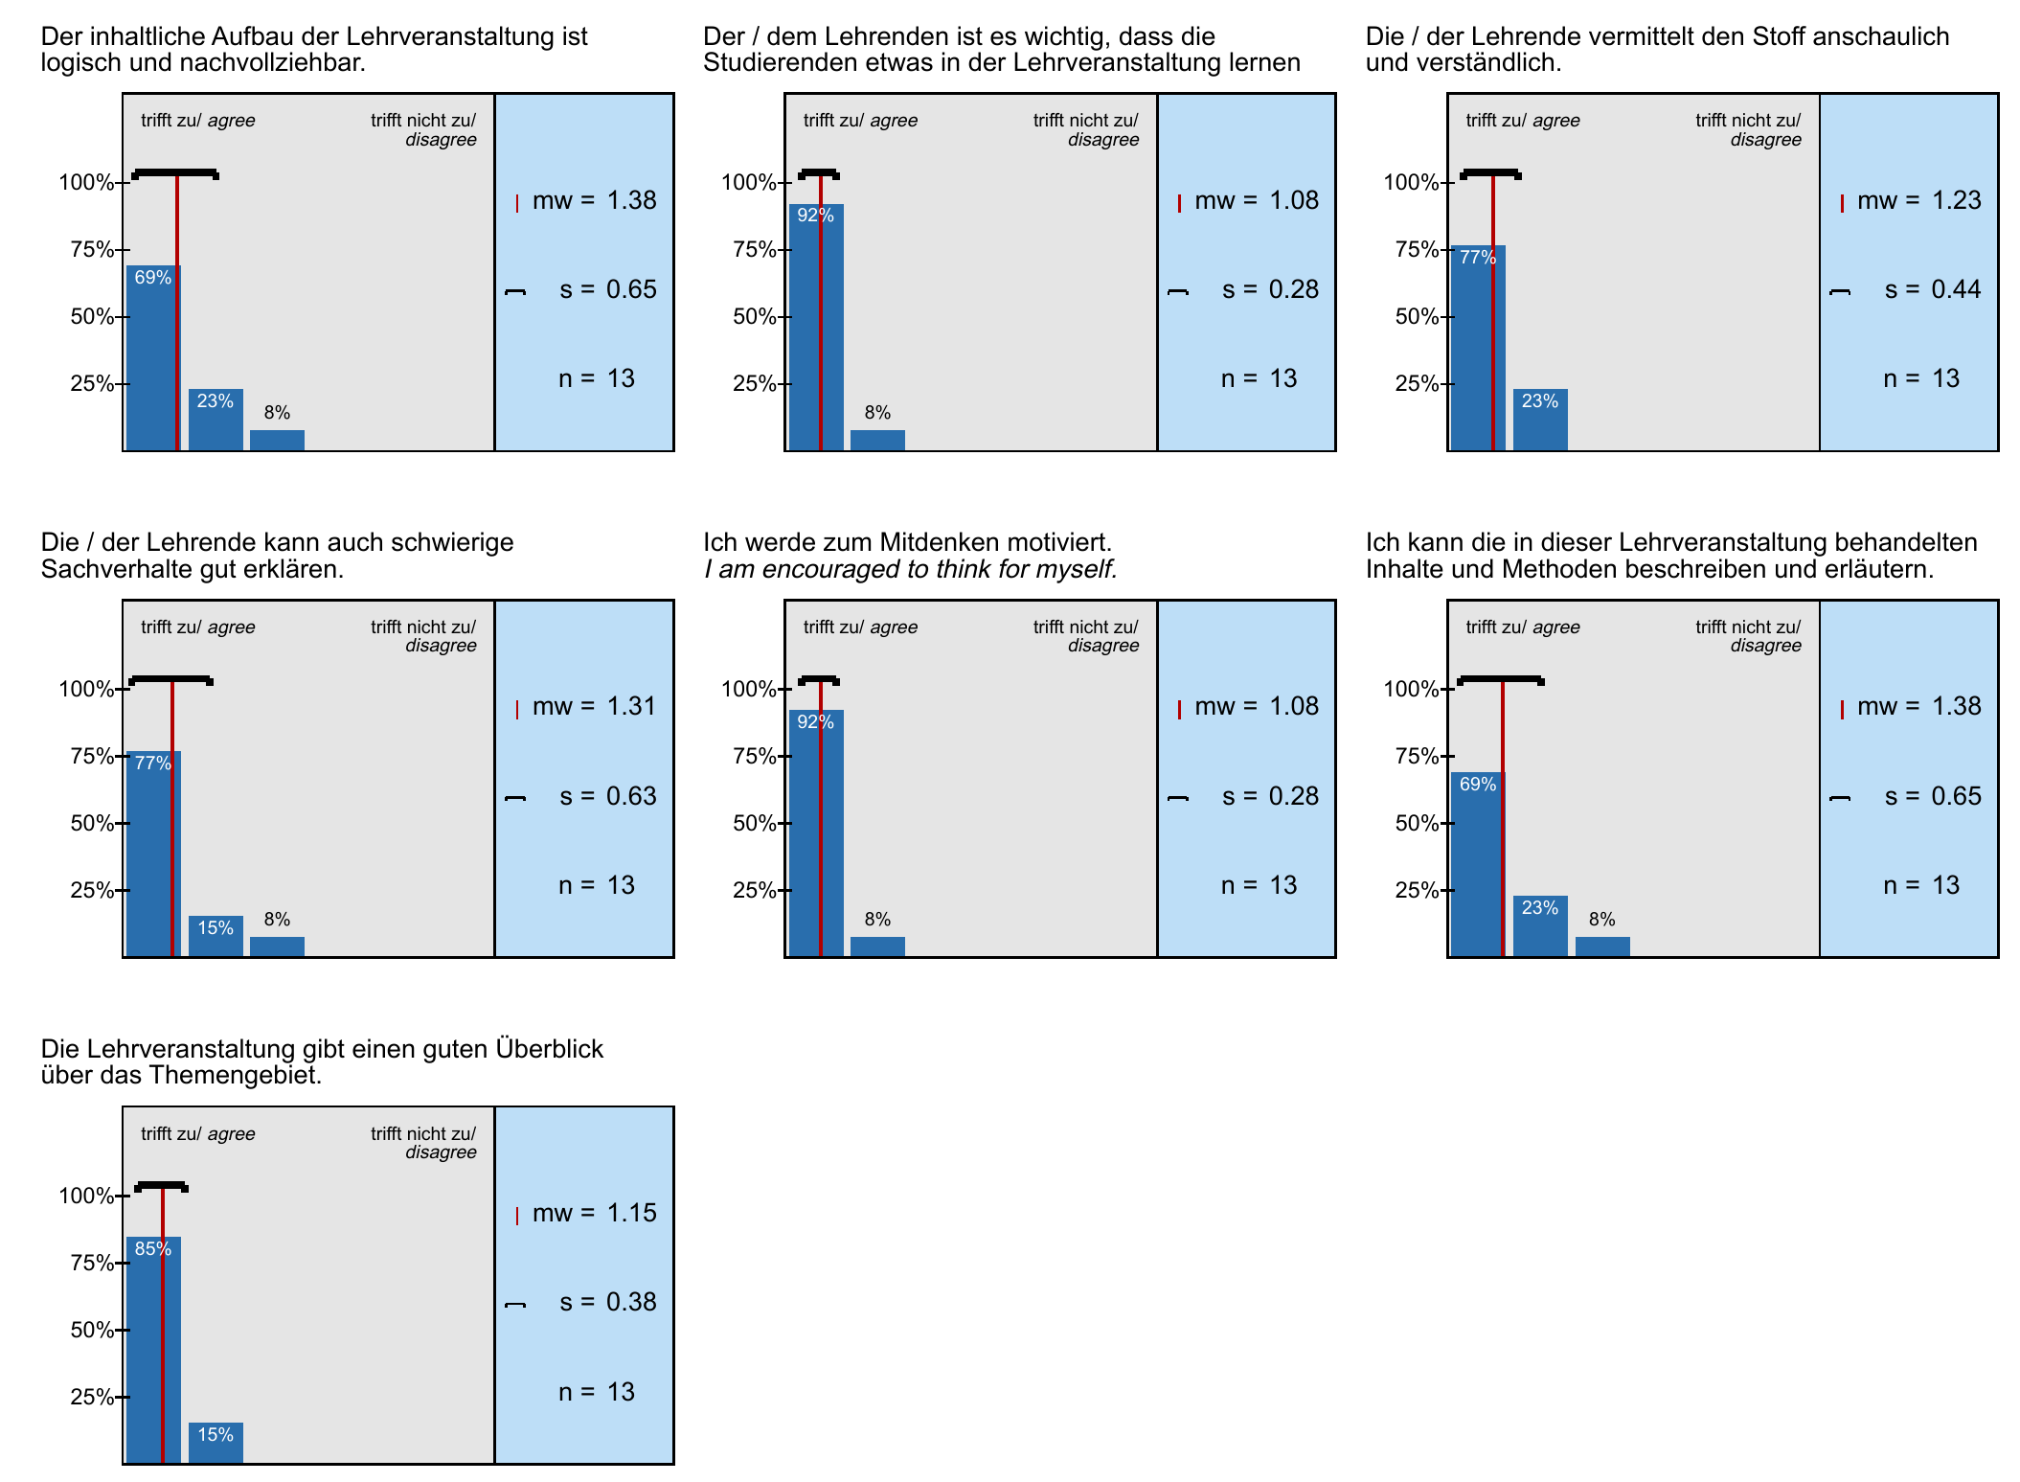
Course Evaluation Results
Feedback

Slide 6
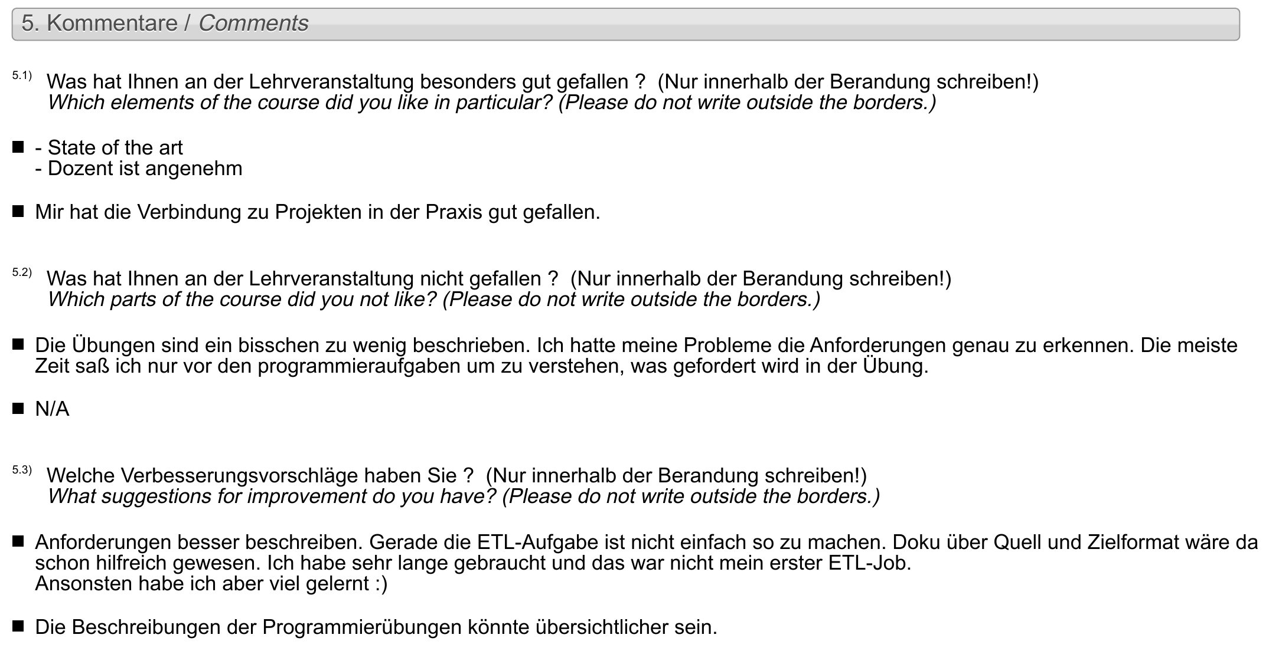
Course Evaluation Results
Feedback

Slide 7
Bonus Task
Feedback
Two video submissions:
Sustainify
Value-based Recovery Design For End-of-Life Products
We will have a look at the video submissions during the Q&A session

Slide 8
Bonus Task
Feedback
Two video submissions:
Sustainify
Value-based Recovery Design For End-of-Life Products
We will have a look at the video submissions during the Q&A session

Slide 9
BLOCKCHAINS AND SUSTAINABILITY

Slide 10
Two main perspectives
Sustainability of Blockchains
VS
Blockchains for Sustainability

Slide 11
Sustainability of Blockchains
Quick Recap/Takeaway of Dr. Gallersdörfer’s Talk
PoW Blockchains suffer from energy inefficiency issues → they may not be the best way to achieve decentralized concensus.
BUT PoW is not the be-all and end-all of blockchains.
We know there are better consensus mechanisms.

Slide 12
Sustainability of Blockchains
Decoupling Resource Consumption and Potential Utility
The utility of blockchains in solving issues and making the world more sustainable, far overweighs the disadvantages of early concensus mechanisms.
Circular Economy models are designed to decouple resource consumption and economic growth.

Slide 13
Sustainability of Blockchains
Decoupling Resource Consumption and Potential Utility
The utility of blockchains in solving issues and making the world more sustainable, far overweighs the potential disadvantages of early concensus mechanisms.
Circular Economy models are designed to decouple resource consumption and economic growth.
→ For this lecture, we decouple resource consumption of blockchains and their potential utilty towards sustainabilty.

Slide 14
BLOCKCHAINS FOR SUSTAINABILITY

Slide 15
Blockchains for Sustainability
Question
Which of the following properties of Blockchains would you value the most, when it comes to the potential utility for “making the world more sustainable / the economy more circular” ?
Verifiability / Traceability / Transparency
Decentralizing aspects (concensus)
Immutability
Security (e.g., preventing double-spending)
(Psuedo-) Anonymity

Slide 16
Blockchains for Sustainability
Example Use-Cases
Emmissions Trading
Sustainable Energy
Sustainable Mobility
Sustainable Supply-chain management

Slide 17
Blockchains for Sustainability
Example Use-Cases
Emissions Trading
Sustainable Energy
Sustainable Mobility
Sustainable Supply-chain management

Slide 18
Emissions Trading
Quick Introduction
An approach to limit climate change by creating a market with limited allowances for emissions. (Cap and Trade)
Regulators set a quantitative total limit on the emissions produced by participating polluters (e.g., oil companies).
A polluter having more emissions than their assigned quota MUST purchase the right to emit more.
A polluter emitting fewer emissions than their assigned quota CAN sell their remainder to other polluters.
One of the most common policy adopted by countries to meet their pledges under the Paris Agreement.
https://en.wikipedia.org/wiki/Carbon_emission_trading

Slide 19
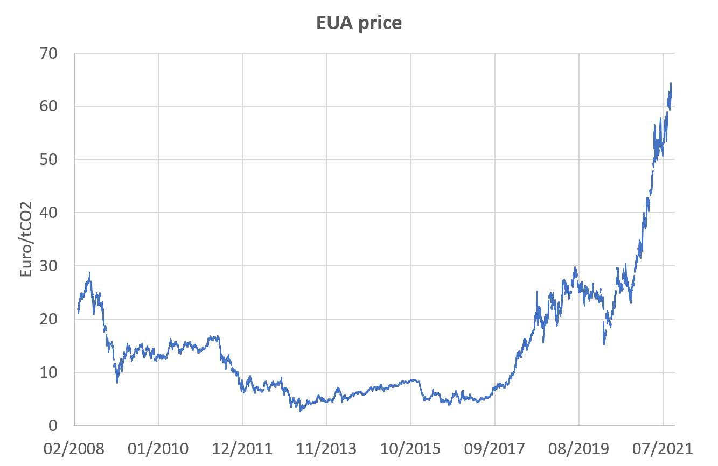
Emissions Trading
EU-ETS
EU’s Emissions Trading System (EU-ETS):
Currently covers ~45% of the EU’s emissions.
Includes power producers, aviation industry and manufacturing.
EU Commission proposed to include maritime emissions into the ETS in 2020.
https://en.wikipedia.org/wiki/European_Union_Emissions_Trading_System
“EUA prices in the EU-ETS until 2021-10” authored by Allavion is licensed under CC BY-SA 4.0 International

Slide 20
Emissions Trading
EU-ETS: Problems and Criticisms
What about the remaining ~55%?
At least 10 differrent types of fraudulent activities are possible:
Double counting
Exploitation of weak regulations
Tax fraud
Oversupply of emissions allowances
https://en.wikipedia.org/wiki/European_Union_Emissions_Trading_System
Mandaroux, Rahel, Chuanwen Dong, and Guodong Li. 2021. "A European Emissions Trading System Powered by Distributed Ledger Technology: An Evaluation Framework" Sustainability 13, no. 4: 2106. https://doi.org/10.3390/su13042106
“EUA prices in the EU-ETS until 2021-10” authored by Allavion is licensed under CC BY-SA 4.0 International

Slide 21
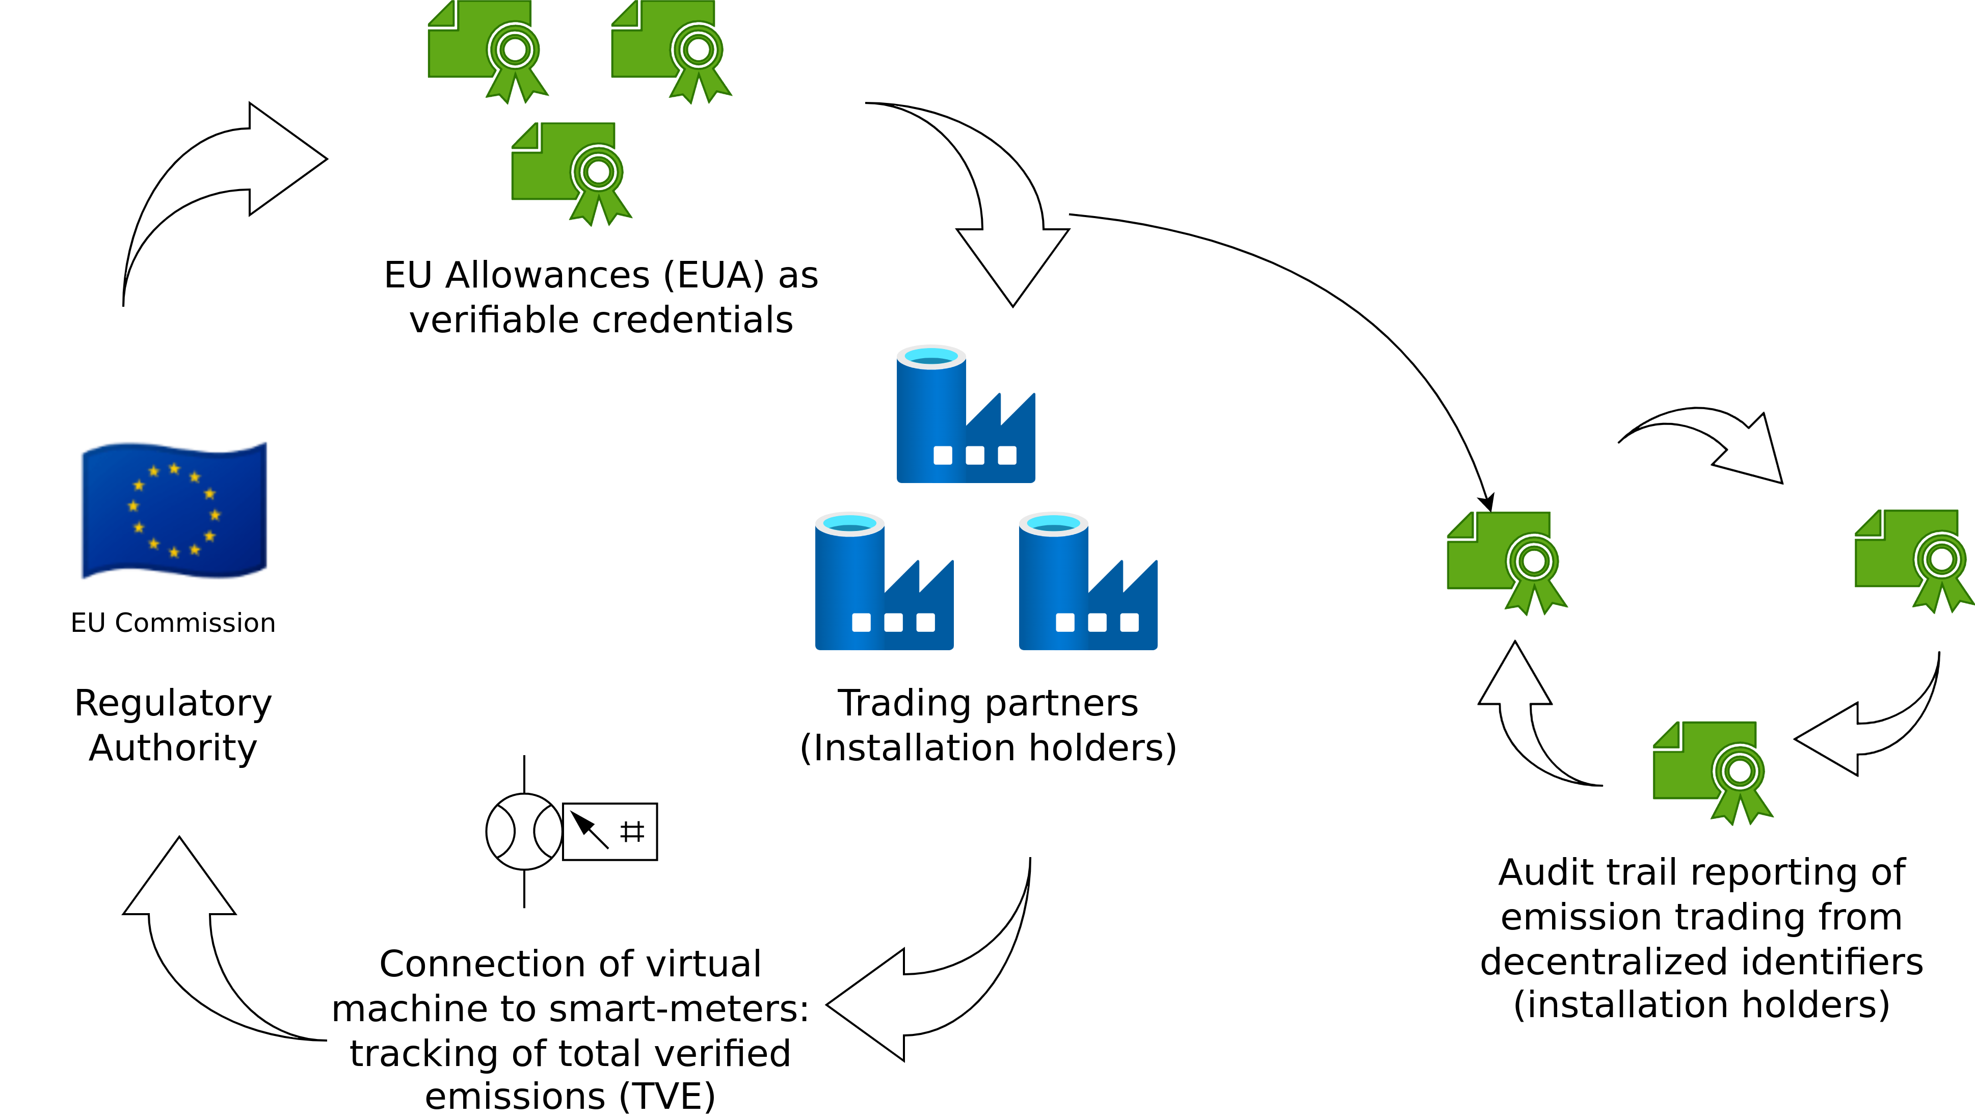
Emissions Trading
EU-ETS on a Blockchain
A conceptual idea for digitizing the EU-ETS in a decentralized and transparent way.
Installation holders (trading participants) use Decentralized Identifiers (DIDs) as an anchor to their identity.
Regulatory autorities assign allowances to the partners in the form of a digital certificate (Verifiable Credentials), which serve as the emissions certificate.
Installation holders have a unique wallet that represents their DID, emission credits, and auditable transaction history.
Smart contract connected smart meters, can further automate tracking of verified emissions.
Mandaroux, Rahel, Chuanwen Dong, and Guodong Li. 2021. "A European Emissions Trading System Powered by Distributed Ledger Technology: An Evaluation Framework" Sustainability 13, no. 4: 2106. https://doi.org/10.3390/su13042106

Slide 22
Emissions Trading
EU-ETS on a Blockchain
Advantages:
Double counting would be reduced due to more secure unique identification and trade tracking.
With wallet information, each trade can be traced back to the original holder.
Real-time energy data can influence allocation policies in a more efficient way.
Mandaroux, Rahel, Chuanwen Dong, and Guodong Li. 2021. "A European Emissions Trading System Powered by Distributed Ledger Technology: An Evaluation Framework" Sustainability 13, no. 4: 2106. https://doi.org/10.3390/su13042106

Slide 23
Emissions Trading
EU-ETS on a Blockchain
Disadvantages
A very generalized framework
Does not address all types of fraudulent activities.
Does not fix the ~55% of emissions that are not traded in the system.
Adoption of digitization through blockchains regarding traceability and transaparency is still a general issue.
Mandaroux, Rahel, Chuanwen Dong, and Guodong Li. 2021. "A European Emissions Trading System Powered by Distributed Ledger Technology: An Evaluation Framework" Sustainability 13, no. 4: 2106. https://doi.org/10.3390/su13042106

Slide 24
Blockchains for Sustainability
Example Use-Cases
Emissions Trading
Sustainable Energy
Sustainable Mobility
Sustainable Supply-chain management

Slide 25
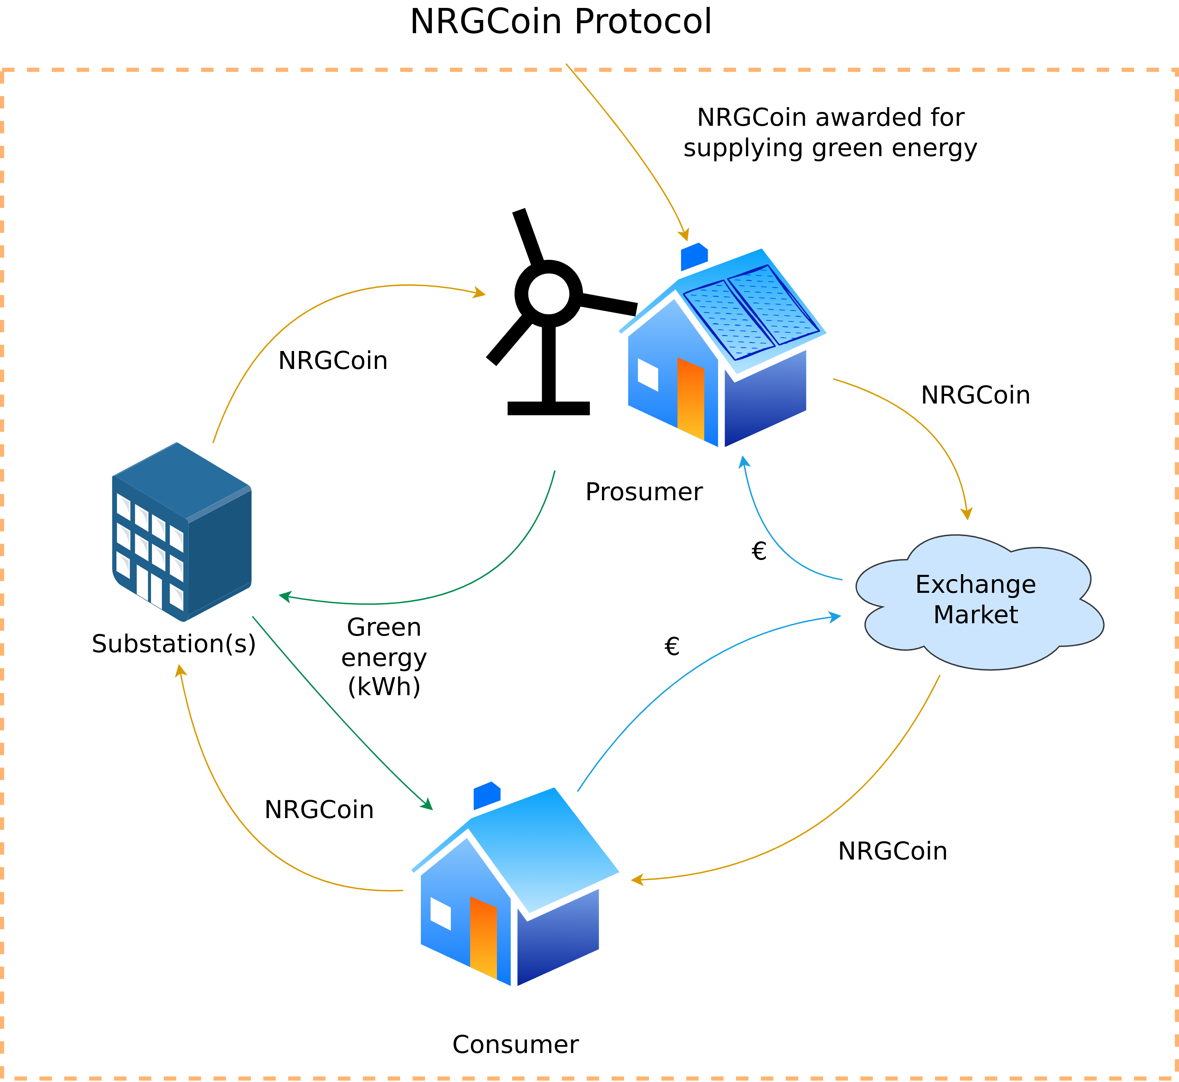
Sustainable Energy
Example: NRGCoin
Incentivization of production and consumption of locally sourced renewable energy using a blockchain.
The protocol converts locally produced renewable energy to NRGCoins. (1 kWh = 1 NRGCoin)
NRGCoin can be exchanged for standard currencies at any time (€, $, …).
Producers do not rely on batteries, but continuously feed energy into the grid.
Payment (NRGCoin) is received based on actual usage, as consumption is monitored in real-time.
Video
Mihaylov M, Jurado S, Avellana N, Van Moffaert K, de Abril IM, Nowé A. NRGcoin: Virtual currency for trading of renewable energy in smart grids. In 11th International conference on the European energy market (EEM14) 2014 May 28 (pp. 1-6). IEEE.

Slide 26
Sustainable Energy
Example: NRGCoin
Advantages
Owning NRGCoin serves as a right to receive an equivalent quantity of energy in the future, independent of the NRGCoin market value. → increases prosumer’s revenue without the need for batteries. (Although batteries would also increase their profits)
Unlike Bitcoin, which is mined through energy expenditure, NRGCoin is generated by injecting useful renewable energy to the grid.
Mihaylov M, Jurado S, Avellana N, Van Moffaert K, de Abril IM, Nowé A. NRGcoin: Virtual currency for trading of renewable energy in smart grids. In 11th International conference on the European energy market (EEM14) 2014 May 28 (pp. 1-6). IEEE.

Slide 27
Blockchains for Sustainability
Example Use-Cases
Emissions Trading
Sustainable Energy
Sustainable Mobility
Sustainable Supply-chain management

Slide 28

Sustainable Mobility
M2X Economy
Machine-to-Human (M2H)
For example → Transportation-as-a-Service

Slide 29

Sustainable Mobility
M2X Economy
Machine-to-Machine (M2M)
For example → Road space negotiations

Slide 30

Sustainable Mobility
M2X Economy
Machine-to-Infrastructure (M2I)
For example → Smart parking, battery charging or traffic information

Slide 31
Sustainable Mobility
M2X Economy
Machine-to-Human (M2H)
+
Machine-to-Machine (M2M)
+
Machine-to-Infrastructure (M2I)
=
Machine-to-Everything (M2X)
<number>

Slide 32
Blockchains for Sustainability
Example Use-Cases
Emissions Trading
Sustainable Energy
Sustainable Mobility
Sustainable Supply-chain management

Slide 33
Sustainable Supply-chain management
In Theory
What if we could..
Manage supply chain logistics using a public blockchain,
With incentive structures for sustainable energy, reduction in emissions and waste production,
Logistical infrastructure to enable circular economy practices.
Image adapted from https://www.ellenmacarthurfoundation.org/circular-economy/concept/infographic

Slide 34
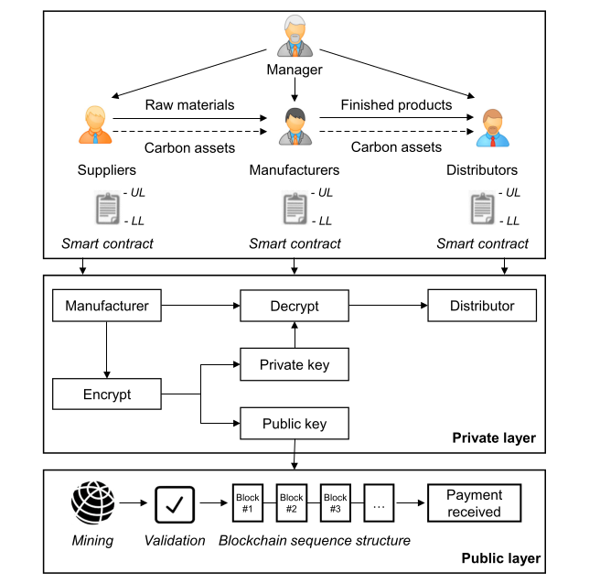
Sustainable Supply-chain management
In Literature
V. K. Manupati, Tobias Schoenherr, M. Ramkumar, Stephan M. Wagner, Sai Krishna Pabba & R. Inder Raj Singh (2019): A blockchain-based approach for a multi-echelon sustainable supply chain, International Journal of Production Research, DOI: 10.1080/00207543.2019.1683248

Slide 35
Sustainable Supply-chain management
In Practice: Walmart + IBM Food Trust
Motivation: Food contamination traceability
Heterogeneous record-keeping methods
Supply chain participants know only the immediate supplier (one link up the chain) and the immediate customer (one link down the chain).
Lack of accurate and adequate information leads to entire batches of food being thrown out in cases of food contamination.
Kamath, Reshma. 2018. “Food Traceability on Blockchain: Walmart’s Pork and Mango Pilots with IBM.” The Journal of The British Blockchain Association 1 (1). https://doi.org/10.31585/jbba-1-1-(10)2018.

Slide 36
Sustainable Supply-chain management
In Practice: Walmart + IBM Food Trust
Implementation
Permissioned blockchain developed in conjunction with IBM
Based on Hyperledger Fabric
Proof of Concept (2016):
Mangoes in the US → Reduced the time needed to trace provenence from 7 days to 2.2 seconds.
IBM Food Trust (2017)
Walmart + IBM + Nestle + Unilever
Expansion to other products (2018)
Walmart now traces 25 products from 5 suppliers.
mangoes, strawberries and leafy greens, meat and dairy products, baby foods.
Planned expansion to all leafy greens
“How Walmart brought Unprecedented transparency to the food supply chain with Hyperledger Fabric” - Link

Slide 37
Blockchains for Sustainability
Quick reflection on the most valued properties
Which of the following properties of Blockchains would you value the most, when it comes to the potential utility for “making the world more sustainable / the economy more circular” ?
Verifiability / Traceability / Transparency
Decentralizing aspects (concensus)
Immutability
Security (e.g., preventing double-spending)
(Psuedo-) Anonymity

Slide 38
Blockchains for Sustainability
Disadvantages and Adoption barriers
Technological barriers
Organizational barriers
Environmental barriers
Inter-Organizational barriers
External barriers
Kouhizadeh, Mahtab, Sara Saberi, and Joseph Sarkis. "Blockchain technology and the sustainable supply chain: Theoretically exploring adoption barriers." International Journal of Production Economics 231 (2021): 107831.

Slide 39
Blockchains for Sustainability
Technological Barriers
Transaction speed
Accumulating transaction costs
Scalability
Immutability
Any private data going into a blockchain will stay there forever.
Incorrect environmental or social record could exist forever, even though latest data seeks to correct such information.
Public Image and perceptions
Kouhizadeh, Mahtab, Sara Saberi, and Joseph Sarkis. "Blockchain technology and the sustainable supply chain: Theoretically exploring adoption barriers." International Journal of Production Economics 231 (2021): 107831.

Slide 40
Blockchains for Sustainability
Organizational Barriers
Financial constraints tied to developing a blockchain-based system
Planning, development, deployment, management
Lack of knowledge and expertise
Lack of commitment from top or middle management
Why would they invest in a new sustainable technology if it hurts their bottom line?
Kouhizadeh, Mahtab, Sara Saberi, and Joseph Sarkis. "Blockchain technology and the sustainable supply chain: Theoretically exploring adoption barriers." International Journal of Production Economics 231 (2021): 107831.

Slide 41
Blockchains for Sustainability
Environmental Barriers
Inter-Organizational barriers
“Organizations are skeptical about sharing their information as they see information as a competitive edge.”
Cultural and geological differences: e.g., heterogeneous definitions of sustainability, circular economy, etc.
External barriers
Lack of governmental incentives towards using blockchains for sustainability due to it’s bad public image.
Novelty and instability of blockchains.
Kouhizadeh, Mahtab, Sara Saberi, and Joseph Sarkis. "Blockchain technology and the sustainable supply chain: Theoretically exploring adoption barriers." International Journal of Production Economics 231 (2021): 107831.

Slide 42
Blockchains for Sustainability
A Contradictory Philosophy
The more trust, verifiability and traceability you would like from a (public) blockchain, the more data you need to store.
Among others issues, this increases the risk of potential barriers to adoption.
This leads to alternative solutions like private/protected blockchains.
→ Little to no public verifiability: How can we know if a proposed solution is not greenwashing us?

Slide 43
Blockchains for Sustainability
A Contradictory Philosophy
The more trust, verifiability and traceability you would like from a (public) blockchain, the more data you need to store.
Among others issues, this increases the risk of potential barriers to adoption.
This leads to alternative solutions like private/protected blockchains.
→ Little to no public verifiability: How can we know if a proposed solution is not greenwashing us?
Is there a better philosophy that works better ? / An alternative way to approach the problem of sustainability?

Slide 44
A short detour: Circular SOCIETy

Slide 45
Circular Society
CE Criticism
Replace the LE with circularly oriented forms of consumption and production
CE focus mostly on earned value management: product/business model innovations within existing power asymmetries
Decouple economic growth and consumption of natural resources
→ But why do we need neverending economic growth and why is it good to consume as many goods and services as possible?
Alternatives:
Sufficiency strategies and lifestyle changes
Question the prevailing entrepreneurial orientation towards the shareholder concept
Deconstruction of existing power and hegemonic relations
Partially based on: F. Hofmann, J. Zwiers (2018) – Circular Society – Eine pluralistische und emanzipatorische Alternative zur Circular Economy? – Link.
.

Slide 46
Circular Society
CE Criticism
Replace the LE with circularly oriented forms of consumption and production
CE focus mostly on earned value management: product/business model innovations within existing power asymmetries
Decouple economic growth and consumption of natural resources
→ But why do we need never ending economic growth and why is it good to consume as many goods and services as possible?
Alternatives:
Sufficiency strategies and lifestyle changes
Question the prevailing entrepreneurial orientation towards the shareholder concept
Deconstruction of existing power and hegemonic relations
Partially based on: F. Hofmann, J. Zwiers (2018) – Circular Society – Eine pluralistische und emanzipatorische Alternative zur Circular Economy? – Link.
.

Slide 47
Circular Society
CE Criticism
Replace the LE with circularly oriented forms of consumption and production
CE focus mostly on earned value management: product/business model innovations within existing power asymmetries
Decouple economic growth and consumption of natural resources
→ But why do we need never ending economic growth and why is it good to consume as many goods and services as possible?
Alternatives:
Sufficiency strategies and lifestyle changes
Question the prevailing entrepreneurial orientation towards the shareholder concept
Deconstruction of existing power asymmetries.
Partially based on: F. Hofmann, J. Zwiers (2018) – Circular Society – Eine pluralistische und emanzipatorische Alternative zur Circular Economy? – Link.
.

Slide 48
Circular Society
Overview
Circular Society → CS
Goals of the CS:
Not just “CE + social”
Socio-political transformation and reorganization
Replace intransparent and inequity-based value chains of the LE with democratic, transparent and cooperatively organized value chains
Also → preserve the environment/ressources for present and future generations and enable social participation and quality of life
All-encompassing change necessary if the CE is to be the subject of a socio-ecological transformation
Democratisation of value creation processes and strategies for the activation and emancipation of different stakeholder groups
Partially based on: F. Hofmann, J. Zwiers (2018) – Circular Society – Eine pluralistische und emanzipatorische Alternative zur Circular Economy? – Link.
.

Slide 49
Circular Society
Overview
Circular Society → CS
Goals of the CS:
Not just “CE + social”
Socio-political transformation and reorganization
Replace intransparent and inequity-based value chains of the LE with democratic, transparent and cooperatively organized value chains
Also → preserve the environment/resources for present and future generations and enable social participation and quality of life
All-encompassing change necessary if the CE is to be the subject of a socio-ecological transformation
Democratisation of value creation processes and strategies for the activation and emancipation of different stakeholder groups
Partially based on: F. Hofmann, J. Zwiers (2018) – Circular Society – Eine pluralistische und emanzipatorische Alternative zur Circular Economy? – Link.
.

Slide 50
Circular Society
Overview
Circular Society → CS
Goals of the CS:
Not just “CE + social”
Socio-political transformation and reorganization
Replace intransparent and inequity-based value chains of the LE with democratic, transparent and cooperatively organized value chains
Also → preserve the environment/resources for present and future generations and enable social participation and quality of life
All-encompassing change is necessary if the CE is to be the subject of a socio-ecological transformation
Democratization of value creation processes and strategies for the activation and emancipation of different stakeholder groups
Partially based on: F. Hofmann, J. Zwiers (2018) – Circular Society – Eine pluralistische und emanzipatorische Alternative zur Circular Economy? – Link.
.

Slide 51
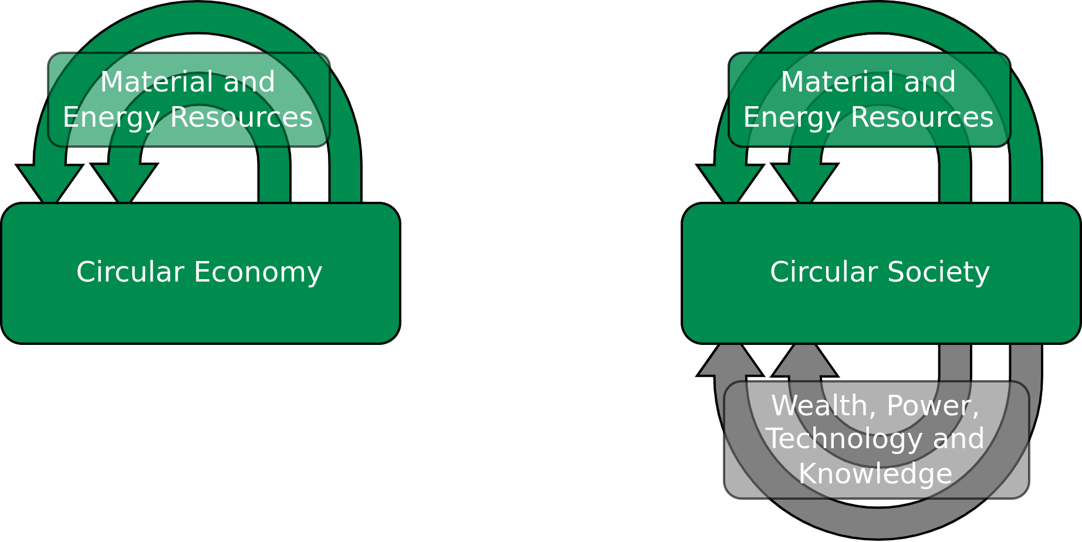
Circular Society
Definition
„ A circular society defines discourses with a vision of circularity where not only resources are circulated in sustainable loops, but also wealth, knowledge, technology and power is
circulated and redistributed throughout society”
Image licensed under CC BY-SA 4.0, sourced from M. C. Friant, R. Salomone, W. J. V. Vermeulen (2020) – A Typology of Circular Economy Discourses: Navigating the Diverse Visions of a Contested Paradigm – Link

Slide 52
Circular Society
Conclusion
Circular Economy (CE):
Maintain natural resources and minimize the discharge of substances that are harmful to health and nature → Increase/maximize utilization of resources, e.g., Performance Economy
Ecological modernization of the economy to increase resource efficiency, e.g., by technical innovation and digital solutions.
Circular Society (CS):
Not just “CE + social” instead socio-political transformation and reorganization
Replace non-transparent and inequity-based value chains of the LE with democratic, transparent and cooperatively organized value chains.
Democratization of value creation processes and strategies for the activation and emancipation of different stakeholder groups

Slide 53
Blockchains for Sustainability
A Contradictory Philosophy
The more trust, verifiability and traceability you would like from a (public) blockchain, the more data you need to store.
Among others issues, this increases the risk of potential barriers to adoption.
This leads to alternative solutions like private/protected blockchains.
→ Little to no public verifiability: How can we know if a proposed solution is not greenwashing us?
Is there a better philosophy that works better ? / An alternative way to approach the problem of sustainability? = Blockchains for Circular Societies?

Slide 54
Blockchains for Circular Societies
Quick reflection on the most valued properties
Which of the following properties of Blockchains would you value the most, when it comes to the potential utility for “making the world more sustainable / the economy more circular” ?
Verifiability / Traceability / Transparency
Decentralizing aspects (concensus)
Immutability
Security (e.g., preventing double-spending)
(Psuedo-) Anonymity

Slide 55
Future work
A Possibly Unexplored Research Area
Incentivise circular flows of material, energy, wealth, power, knowledge and technology.
Localized currency
Incentivise local supply chains
Resolving scalability issues
Alleviating organizational and environmental barriers
Enable decentralized governing principles using smart contracts.
Can such a system co-exist, while simultaneously transforming the status quo?
Can individual localized circular societies interact (trade) with each other, expanding to a global level?
How can blockchains help develop and reliably “sustain” circular societies?

Slide 56
Conclusions
Possible utility of blockchains
Emmissions Trading
Sustainable Energy
Sustainable Mobility
Sustainable Supply-chain management
Most scientific literature agrees that blockchains can be a driving force to design circular economic business models.

Slide 57
Conclusions
However, various adoption barriers prevent the most valued attributes of blockchains being used in an efficient manner.
Organizational barriers
Environmental barriers
Circular Economy VS Circular Society
Replace intransparent and inequity-based value chains of the LE with democratic, transparent and cooperatively organized value chains
Also → preserve the environment/resources for present and future generations and enable social participation and quality of life
All-encompassing change is necessary if the CE is to be the subject of a socio-ecological transformation

Slide 58
Conclusions
However, various adoption barriers prevent the most valued attributes of blockchains being used in an efficient manner.
Organizational barriers
Environmental barriers
Circular Economy VS Circular Society
Replace intransparent and inequity-based value chains of the LE with democratic, transparent and cooperatively organized value chains
Also → preserve the environment/resources for present and future generations and enable social participation and quality of life
All-encompassing change is necessary if the CE is to be the subject of a socio-ecological transformation
Blockchains can be the backbone of such transformational change

Slide 59
Questions?

Slide 60
Additional Resources
Thalhammer, Felix, Pascal Schöttle, Matthias Janetschek, and Christian Ploder. "Blockchain Use Cases Against Climate Destruction." Cloud Computing and Data Science (2022): 22-38.
Kamath, Reshma. "Food traceability on blockchain: Walmart’s pork and mango pilots with IBM." The Journal of the British Blockchain Association 1, no. 1 (2018): 3712. Link
https://www.hyperledger.org/wp-content/uploads/2019/02/Hyperledger_CaseStudy_Walmart_Printable_V4.pdf
Kouhizadeh, Mahtab, Sara Saberi, and Joseph Sarkis. "Blockchain technology and the sustainable supply chain: Theoretically exploring adoption barriers." International Journal of Production Economics 231 (2021): 107831.

